Slide 1

ECE 2700
Digital Circuits
Register Files
Copyright © 2010 Frank Vahid
Instructors of courses requiring Vahid's Digital Design textbook (published by John Wiley and Sons) have permission to modify and use these slides for customary course-related activities, subject to keeping this copyright notice in place and unmodified. These slides may be posted as unanimated pdf versions on publicly-accessible course websites.. PowerPoint source (or pdf with animations) may not be posted to publicly-accessible websites, but may be posted for students on internal protected sites or distributed directly to students by other electronic means. Instructors may make printouts of the slides available to students for a reasonable photocopying charge, without incurring royalties. Any other use requires explicit permission. Instructors may obtain PowerPoint source or obtain special use permissions from Wiley – see http://www.ddvahid.com for information.

Slide 2
Today’s Objectives
To become familiar with the following datapath components
  Register files

Slide 3
Register Files
Set of registers that reside in one component
  MxN register file
    M registers
    N-bit wide
Why needed?

Slide 4
Problems With Separate Registers
Complicated wiring
  Aka routing congestion
  Burden on the designer
Weak signals
Long delays
32
9
C
C
8
d0
load
r
eg0
huge mux
d0
load
r
eg0
T
32
4x
16
×
9
i0
i0
2
4
too much
8
32-bit
d1
load
fanout
9
8-bit
r
eg1
A
4
×
1
4
a0
16x1
i0
9
i1
i3-i0
i1
8
a1
d2
load
r
eg2
9
d
d
D
D
I
32
8
9
i2
8
congestion
d15
d3
load
load
r
eg3
M
16*32 = 512 wires
e
e
r
eg15
load
i3
load
8
i15
s1
s0
32
s3-s0
x
y

Slide 5
Register File Overview
Important observation
  Only need to load one register at a time
Can write one register and read one register each clock cycle
  May be same register
  Read is asynchronous
32-bit data to write
32
32
32-bit data that is read
W_data
R_data
4-bit “address” specifies which register to write
4
4
4-bit address to specifies which register to read
write port
W_addr
R_addr
read port
Enable (load) line: Reg written on next clock
W_en
R_en
Enable read
16
×
32
register file

Slide 6
Register File Timing Diagram
clk
cycle 1
cycle 2
cycle 3
cycle 4
cycle 5
cycle 6
1
2
3
4
5
6
W_data
9
22
X
X
177
555
W_addr
3
1
X
X
2
3
W_en
R_data
Z
Z
Z
9
Z
22
9
555
R_addr
X
X
3
X
1
3
R_en
0:
?
0:
?
0:
?
0:
?
0:
?
0:
?
0:
?
1:
?
1:
?
1:
22
1:
22
1:
22
1:
22
1:
22
2:
?
2:
?
2:
?
2:
?
2:
?
2:
177
2:
177
3:
?
3:
9
3:
9
3:
9
3:
9
3:
9
3:
555
32
32
W_data
R_data
2
W_addr
R_addr
2
W_en
R_en
4x32
register file

Slide 7
Question (AP)
Given the following timing diagram, what’s R_data at the time indicated by the dashed line?
  6
  7
  22
  177
  Z
clk
W_data
9
22
7
177
W_addr
1
0
1
0
W_en
R_addr
0
1
2
3
0
3
R_en
0:
6
Initial register values
1:
10
2:
2
3:
0

Slide 8
Question (AP)
What’s a possible operation that happened at the time denoted by the dashed line? Let’s assume that the delay in writing/reading is 0
  Register 0 is written with 7 as the new value
  An error may have occurred
  Not enough information is given
  None of the above
  ☹
clk
R_data
9
22
7
177
7
R_addr
1
0
1
0
R_en

Slide 9
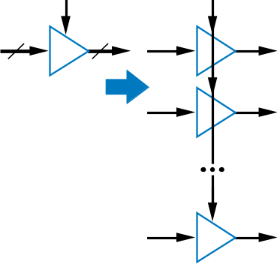
Register File Design
9
Key ideas
  Driver
  Bus
32
9
32
9
W_data
bus
R_data
d0
load
reg0
9
driver
d0
2x4
32
9
2x4
1
d1
load
reg1
9
d1
1
W_addr
i0
32
i0
driver
1
i1
9
i1
1
R_addr
d2
load
reg2
d2
d
q
write
32
read
decoder
1
decoder
q=d
d3
load
9
1
d3
Boosts signal
e
reg3
9
9
e
W_en
32
R_en
1
4x32 register file
1
three-state driver
c
d
q
Note: Each driver in figure actually represents 32 1-bit drivers
c=1: q=d
d
q
c=0: q=Z
d
q
like no connection

Slide 10
Register File Variations
Dual-read ports common
How do you design a single ported register file?
  Read/write on the same port

Slide 11
Verilog Possible Bit Values
In Verilog, a bit can have one of the following value
  0
  1
  Z or z
    High impendance
  X or x
    Undefined
To compare a and b
  Before (value can only be 0 or 1)
    if (a == b), if (a != b)
  Now (value can be Z and/or X)
    if (a === b), if (a !== b)

Slide 12
Designing Register File in Verilog
Let’s start with a single
register
High-impedance
  Represents an output that is
  neither driven high nor
  driven low
  Written as z or Z
`timescale 1 ns/1 ns
module Reg32wOE(I, Q, Oe, Ld, Clk, Rst);
input [31:0] I;
output [31:0] Q;
reg [31:0] Q;
input Oe, Ld;
input Clk, Rst;
reg [31:0] R;
// Register Procedure
always @(posedge Clk) begin
if (Rst == 1)
R <= 32'd0;
else if (Ld == 1)
R <= I;
end
// Output Procedure
always @(R, Oe) begin
if (Oe == 1)
Q <= R;
else
Q <= 32'hZZZZZZZZ;
end
endmodule
32
OE
I
Ld
32-bit Register with Output Enable
Rst
Q
32

Slide 13
Alternative Description
`timescale 1 ns/1 ns
module Reg32wOE(I, Q, Oe, Ld, Clk, Rst);
input [31:0] I;
output [31:0] Q;
reg [31:0] Q;
input Oe, Ld;
input Clk, Rst;
reg [31:0] R;
// Register Procedure
always @(posedge Clk) begin
if (Rst == 1)
R <= 32'd0;
else if (Ld == 1)
R <= I;
end
// Output Procedure
always @(R, Oe) begin
if (Oe == 1)
Q <= R;
else
Q <= 32'hZZZZZZZZ;
end
endmodule
`timescale 1 ns/1 ns
module Reg32wOE(I, Q, Oe, Ld, Clk, Rst);
input [31:0] I;
output [31:0] Q;
input Oe, Ld;
input Clk, Rst;
reg [31:0] R;
// Register Procedure
always @(posedge Clk) begin
if (Rst == 1)
R <= 32'd0;
else if (Ld == 1)
R <= I;
end
assign Q = Oe ? R : 32'hZZZZZZZZ;
endmodule
Outside of the always statement so Q is not declared as a reg
A ? B : C
  If A is true, result is B
  If A is false, result is C

Slide 14
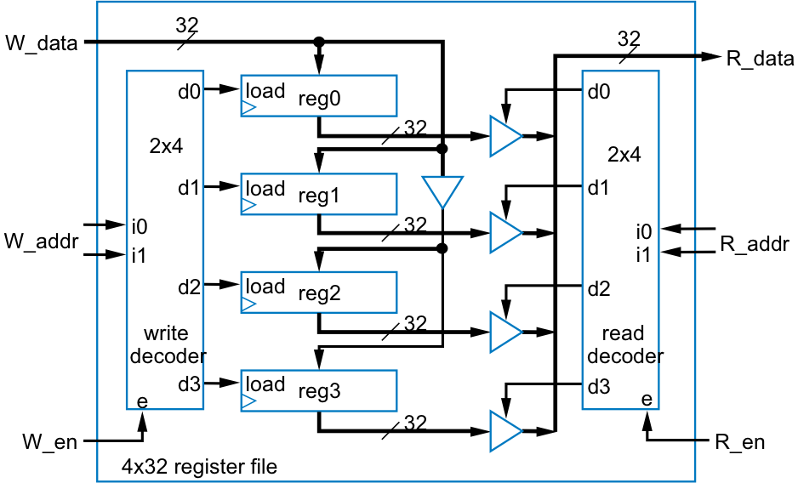
Register File: Structural Design
`timescale 1 ns/1 ns
module RegFile4x32(R_Addr,W_Addr,R_en,W_en,
R_Data,W_Data,Clk,Rst);
input [1:0] R_Addr, W_Addr;
input R_en, W_en;
output [31:0] R_Data;
input [31:0] W_Data;
input Clk, Rst;
wire W_d3, W_d2, W_d1, W_d0;
wire R_d3, R_d2, R_d1, R_d0;
Dcd2x4wEn R_Dcd (R_Addr[1],R_Addr[0],R_en,
R_d3,R_d2,R_d1,R_d0);
Dcd2x4wEn W_Dcd (W_Addr[1],W_Addr[0],W_en,
W_d3,W_d2,W_d1,W_d0);
Reg32wOE Reg0 (W_Data,R_Data,R_d0,W_d0,Clk,Rst);
Reg32wOE Reg1 (W_Data,R_Data,R_d1,W_d1,Clk,Rst);
Reg32wOE Reg2 (W_Data,R_Data,R_d2,W_d2,Clk,Rst);
Reg32wOE Reg3 (W_Data,R_Data,R_d3,W_d3,Clk,Rst);
endmodule
Four drivers for R_data
One from each Reg32wOE instantiation

Slide 15
Multiple Drivers For One Net
Resolving multiple driven values into one value done as follows
  0 and z → 0
  1 and z → 1
  z and z → z
  0 and 1 → x

Slide 16
Register File: Behavioral Design
module RegFile4x32(R_Addr, W_Addr, R_en, W_en,
R_Data, W_Data, Clk, Rst);
input [1:0] R_Addr, W_Addr;
input R_en, W_en;
output reg [31:0] R_Data;
input [31:0] W_Data;
input Clk, Rst;
reg [31:0] RegFile [0:3];
// Write procedure
always @(posedge Clk) begin
if (Rst==1) begin
RegFile[0] <= 32'd0;
RegFile[1] <= 32'd0;
RegFile[2] <= 32'd0;
RegFile[3] <= 32'd0;
end
else if (W_en==1) begin
RegFile[W_Addr] <= W_Data;
end
end
// Read procedure
always @* begin
if (R_en==1)
R_Data <= RegFile[R_Addr];
else
R_Data <= 32'hZZZZZZZZ;
end
endmodule
Declare a 4-element array
  Each element 32-bits
    Specified at end of declaration to distinguish from vector range specification
  Array elements accessed using index
    RegFile[0] <= 32'd0;
    Note that vector may be used as array index: RegFile[W_Addr]

Slide 17
Today’s Objectives
To become familiar with the following datapath components
  Register files

Slide 18
Question
Given the following timing diagram, what’s R_data at the time indicated by the dashed line?
clk
W_data
9
22
7
177
W_addr
1
0
1
0
W_en
R_addr
0
1
2
3
0
3
R_en
0:
6
Initial register values
1:
10
2:
2
3:
0

